Slide 1

Helping Students Succeed
Study techniques
Test taking strategies
Test question analysis

Slide 2



Part I: Assessment
Determine what kind of learner they are
Hands on/Tactile/Kinesthetic
Auditory
Visual

Slide 3

How do I assess that as an educator?
Ask them in an interview
  Get a baseline on what they believe they are
  Ask them what they do to study
  Ask them about a new skill they learned and how they went about it
Have them take a test at orientation
  Online resources
  http://www.educationplanner.org/students/self-assessments/learning-styles-quiz.shtml

Slide 4
Kinesthetic/Tactile learners
Use actual models, supplies and instruments
Include learning games
  Kahoot
Include activities where they need to get up and be involved
Take a break q45 minutes (as it allows)
Let them stand
Allow fidget spinners
Allow them to take notes with computers

Slide 5
Techniques for kinesthetic leaners
Move, draw, build, touch
Art projects, walks, act out
Chew gum, walk around
Flashcards, arrange them in groups
Frequent, but not long, breaks
Tap pencil, shake foot, hold on to something
Computer to reinforce, sense of touch

Slide 6
Auditory
Lecture
Plain PowerPoints
Let them record your lectures or instruction in the lab
Let them record videos
Pre-record videos for instruction

Slide 7
Techniques for auditory learners
Sit in the front
Read flashcards & notes out loud
Record themselves and listen
Record lectures (if allowed)

Slide 8
Visual
Pictures in PowerPoints
Provide charts for them to study

Slide 9
Techniques for visual learners
Sit in the front
Try to visualize what is being talked about
Write down key words, instructions
Draw pictures
Color code
Avoid distractions when studying

Slide 10

What can I incorporate for them as an educator?
Figure out what you are
  You may be inclined to create content based on YOUR style
  Make sure you’re incorporating the other styles
Make sure you are designing your content with activities to appeal to all three types of learning styles
  Auditory
  Visual
  Kinesthetic/Tactile

Slide 11

Teaching to different generations
What’s your median age for your program?
Why’s this important?
Generations
  Baby boomers
  Generation X
  Generation Y (Millennials)
  Generation Z

Slide 12

What else can I recommend?
Buy a white board and teach to an empty room or a pet
Pick a familiar movie to play in the background when studying
  Only study for 45 minutes at a time and then take a break
Make up quizzes for themselves with content they are struggling
Make them understand they cannot memorize and dump the content
They must understand why something must be done and they will be able to retain the information and put it into practice
Let’s hear some of your ideas!

Slide 13

Part II: Test questions
What level questions are you asking to prepare them?
Do they know the techniques for answering each type?
Steps for multiple choice questions.

Slide 14
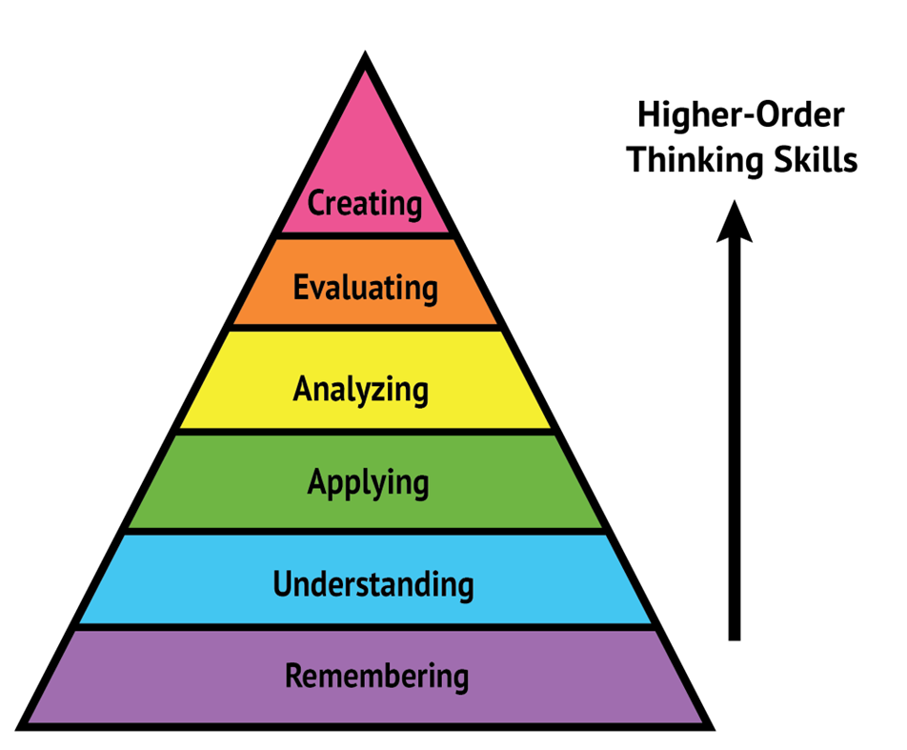
Blooms Taxonomy
Knowledge: Remembering
Comprehension
Application
Analysis
Synthesis
Evaluation

Slide 15
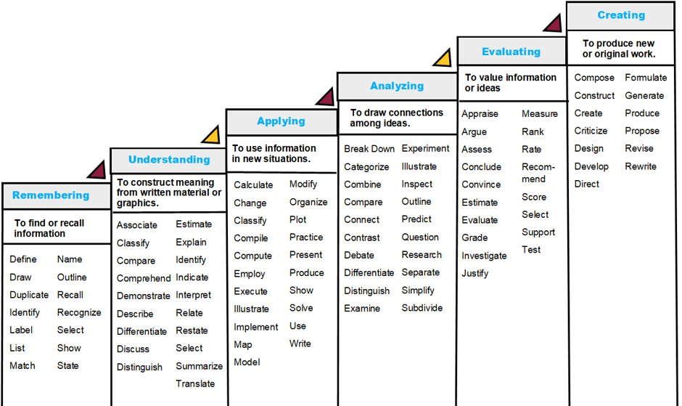
Blooms Taxonomy
Terms you can use for questions

Slide 16
Types of test questions and what they assess
True or false
Matching
Fill in the blank
Knowledge
Knowledge
Knowledge
Comprehension
Multiple choice
Knowledge
Comprehension
Application, Analysis
Critical thinking/problem solving
Short answer
Comprehension
Application
Analysis

Slide 17
How do I assess test questions?
Ask the same question in different ways on a test
  Different level questions/ Blooms Taxonomy
  Ex. 1. Remember The ileum is part of the small intestine. T/F
    True/False
    Matching
  Ex. 2. Understand The ileum is (directional) to the duodenum
    Multiple choice focused on specific topic
  Ex. 3. Applying You are performing an open removal of the appendix. What precautions must you take with instruments used to remove the appendix after they are used in the abdomen?
    Multiple choice: Scenario questions
    Give multiple elements in the questions they need to know to answer the question

Slide 18
How do I assess test questions?
Ask the same question in different ways on a test
  Different level questions/ Blooms Taxonomy
  Ex. 1. Remember
    The sigmoid is part of the small intestine. T/F
  Ex. 2. Understand
    The sigmoid colon is _______ to the duodenum.
      Proximal medial
      Distal lateral
  Ex. 3. Applying
    You are first scrub for an open low anterior colon resection. Which of the following items do you need to prepare while setting up? (Select all that apply)
      Bowel closing tray sigmoidoscope
      EEA stapler Hibbs retractor

Slide 19

Icebreaker question

Slide 20

Part III: Test taking strategies

Slide 21

1. Reading test questions
Cover the answers.
Read the question two times. (Get an answer in your head)
Determine the root of the question.
  What is ACTUALLY being asked.
DO NOT READ INTO THE QUESTIONS!!!
Uncover the answers.
Read ALL the answers!
If you are down to two answers that you can not decide between, reread the question. Did you misinterpret what was being asked? Did you read into it? Did you misread the question?

Slide 22
2. Techniques for each type of question
Multiple Choice
Eliminate the ones that you know are wrong.
Select all that apply questions
Treat them like true/false questions as you go down the answer bank.
All of the above questions
They must ALL be true!
Reverse questions (Except, Untrue)
If you didn’t read correctly and unsure why they’re all true, reread the question.

Slide 23

3. Decision Tree

Slide 24

Step 1:
Read the stem. Can you identify the topic of the question?
No
  Read the answer choices for clues.
Yes
  Proceed to the next step.

Slide 25

Step 2: Try to come up with the answer before you look at the answers.
Do you see the answer?
  No
    Cross off any options you know are incorrect.
  Yes
    Great! Mark it and don’t change your answer!

Slide 26

Step 3:
Come back to the items you were unsure of. Put a mark or write down the number on your paper.
Come back to it after you have finished the test.
Step 5: Did you get clues or the answers?
No
Trust your instincts and pick the one your gut is telling you is right.
Yes
Great! Mark it and don’t change your answer!

Slide 27

Step 4:
Did you get clues or the answers?
No
  Trust your instincts and pick the one your gut is telling you is right.
Yes
  Great! Mark it and don’t change your answer!

Slide 28

Please stop making me cry
Don’t change your answers!
Don’t change your answers!
Don’t change your answers!
Don’t change your answers!
Don’t change your answers!

Slide 29

Encourage questions during test taking
While they’re with you is your chance to help to coach them on these techniques
You can help them navigate

Slide 30

Day of an exam
Do they have test anxiety issues?
What can you do to help them?
Do you have it, is there a story you can share?
Techniques
  Eat a good breakfast
  Avoid caffeine
  Create a routine in the morning
  Give themselves extra time
  Set a music playlist with the same music for the day
  Earplugs
    Keep them in, don’t listen to the other people talking

Slide 31

Make them do some reflection
Let them ask questions right after the exam
  Work through the question with them
Make them perform test question analysis on themselves

Slide 32

Electronic exam
How do they do with an electronic exam? Do we incorporate them in our program?
What can I do to help them?
Incorporate electronic exams into your program
If they are struggling, let them use a paper exam for the first few test and have them transcribe their answers in electronic format
Get an erasable surface (whiteboard) they can write on for each question
Encourage them to ask questions when unsure of what is being asked of them
  When they are with you is the time to help them navigate and read test questions.

Slide 33

Part III: Test question analysis

Slide 34

How can I assess what is working?
Use something that will give you analytics
  LMS
  MindTap
  Boardvitals
  Any other resources?

Slide 35
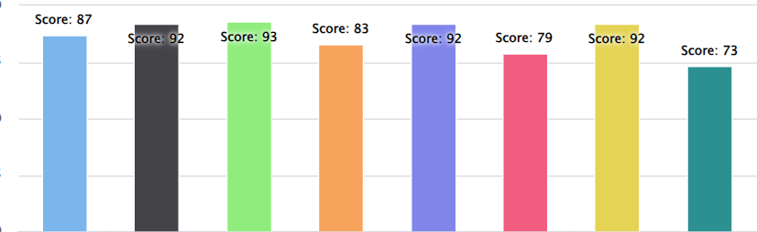
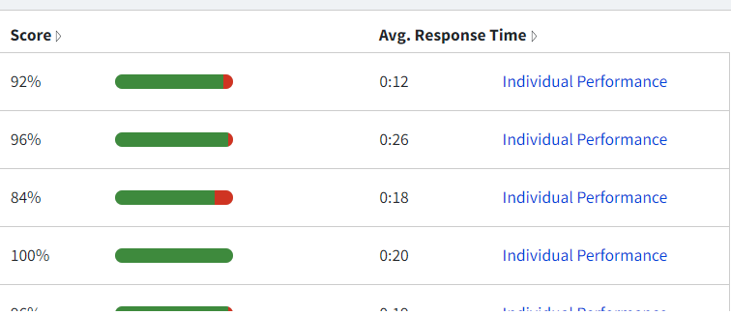
Look at your results
How did your top performers answer the questions?
How did they do on the harder level questions?
How did the same person answer different level questions in the same test?
  Did they know it at level 1 and not level 2 or 3?
  They need help with navigating the questions.

Slide 36
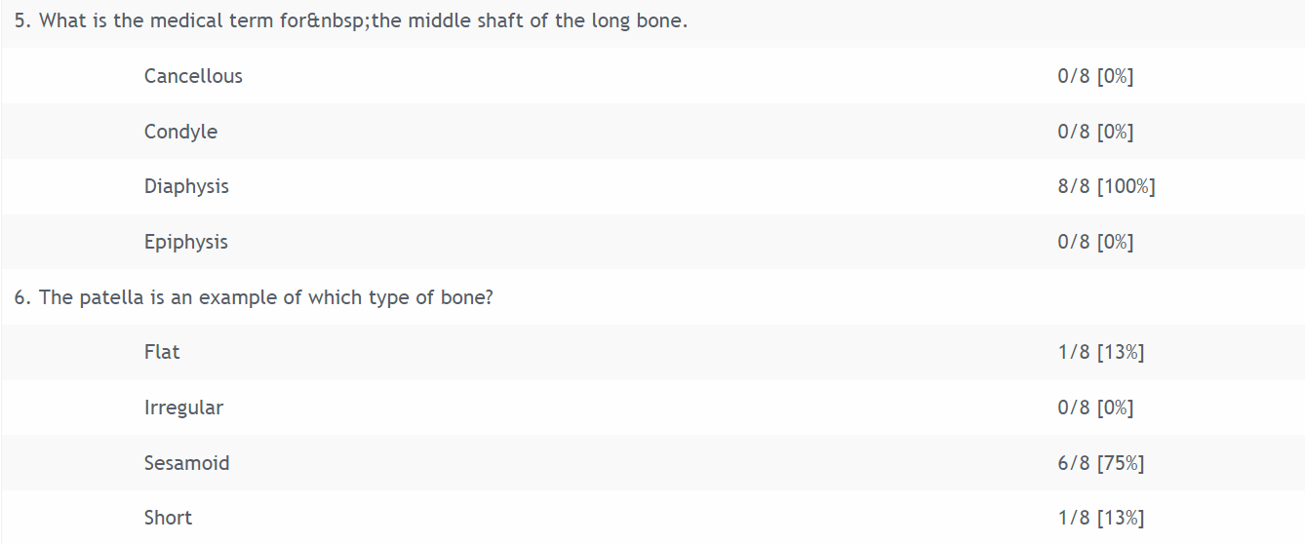
Distractor analysis

Slide 37
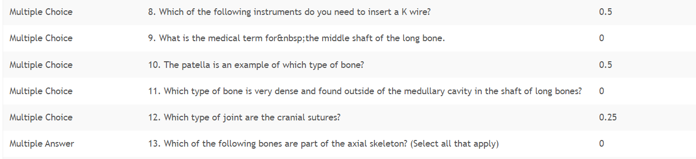
Discrimination Index

Slide 38
Item analysis
How did each person answer each question.
How did those top performers answer?
Did they all get the question wrong?

Slide 39
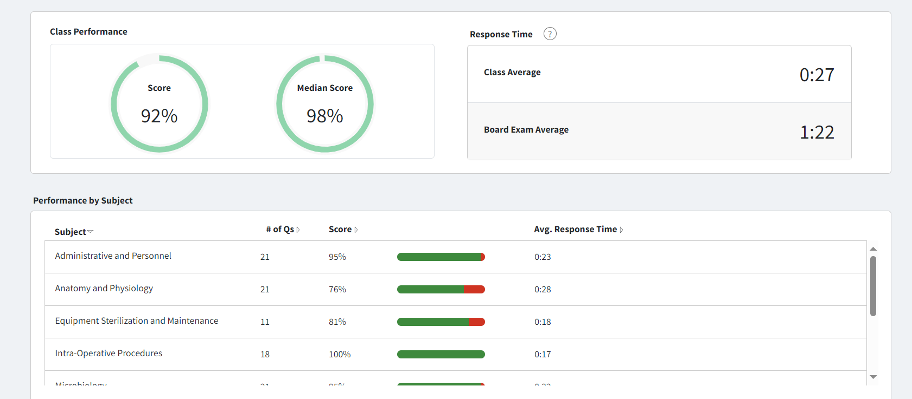
Assessment of class

Slide 40
References
Getty images. (n.d.). Getty images. https://www.gettyimages.com/. Retrieved December 1, 2024, from
Pepperdine Community. (n.d.). Tests & quizzes: Question types [Tests & quizzes: question types]. Retrieved December 1, 2024, from https://community.pepperdine.edu/techlearn/tools/courses/faculty/tests-quizzes-questions.htm#mulitple-choice
https://nursing.kaplan.com/student/docs/classroomposters.pdf
https://www.k-state.edu/ksde/alp/resources/Handout-Module6.pdf
https://www.purdueglobal.edu/education-partnerships/generational-workforce-differences-infographic/

